Slide 1
Tau Beta Pi
The Engineering Honor Society
Integrity & Excellence in Engineering

Slide 2
What is Tau Beta Pi?
1885 - founded at Lehigh University
2015 - 252 chapters & 554,000 members
UMBC = MD-D chapter celebrating 25th Anniversary
Recognizes exceptional engineers and students with exemplary character!
Tau Beta Pi chooses YOU!

Slide 3
Pros of Joining
Best engineering network in the world
Faculty, professionals, graduate students,and UG from CompE, MechE, and ChemE
Work with the most driven and motivated people
Scholarships
All TBP members are eligible to apply
Scholar recipient from MD-D every year

Slide 4
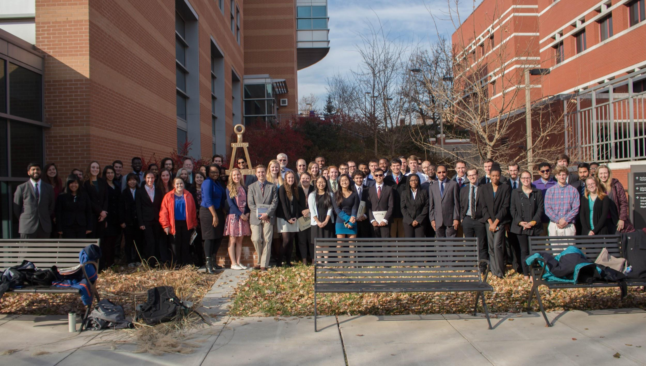
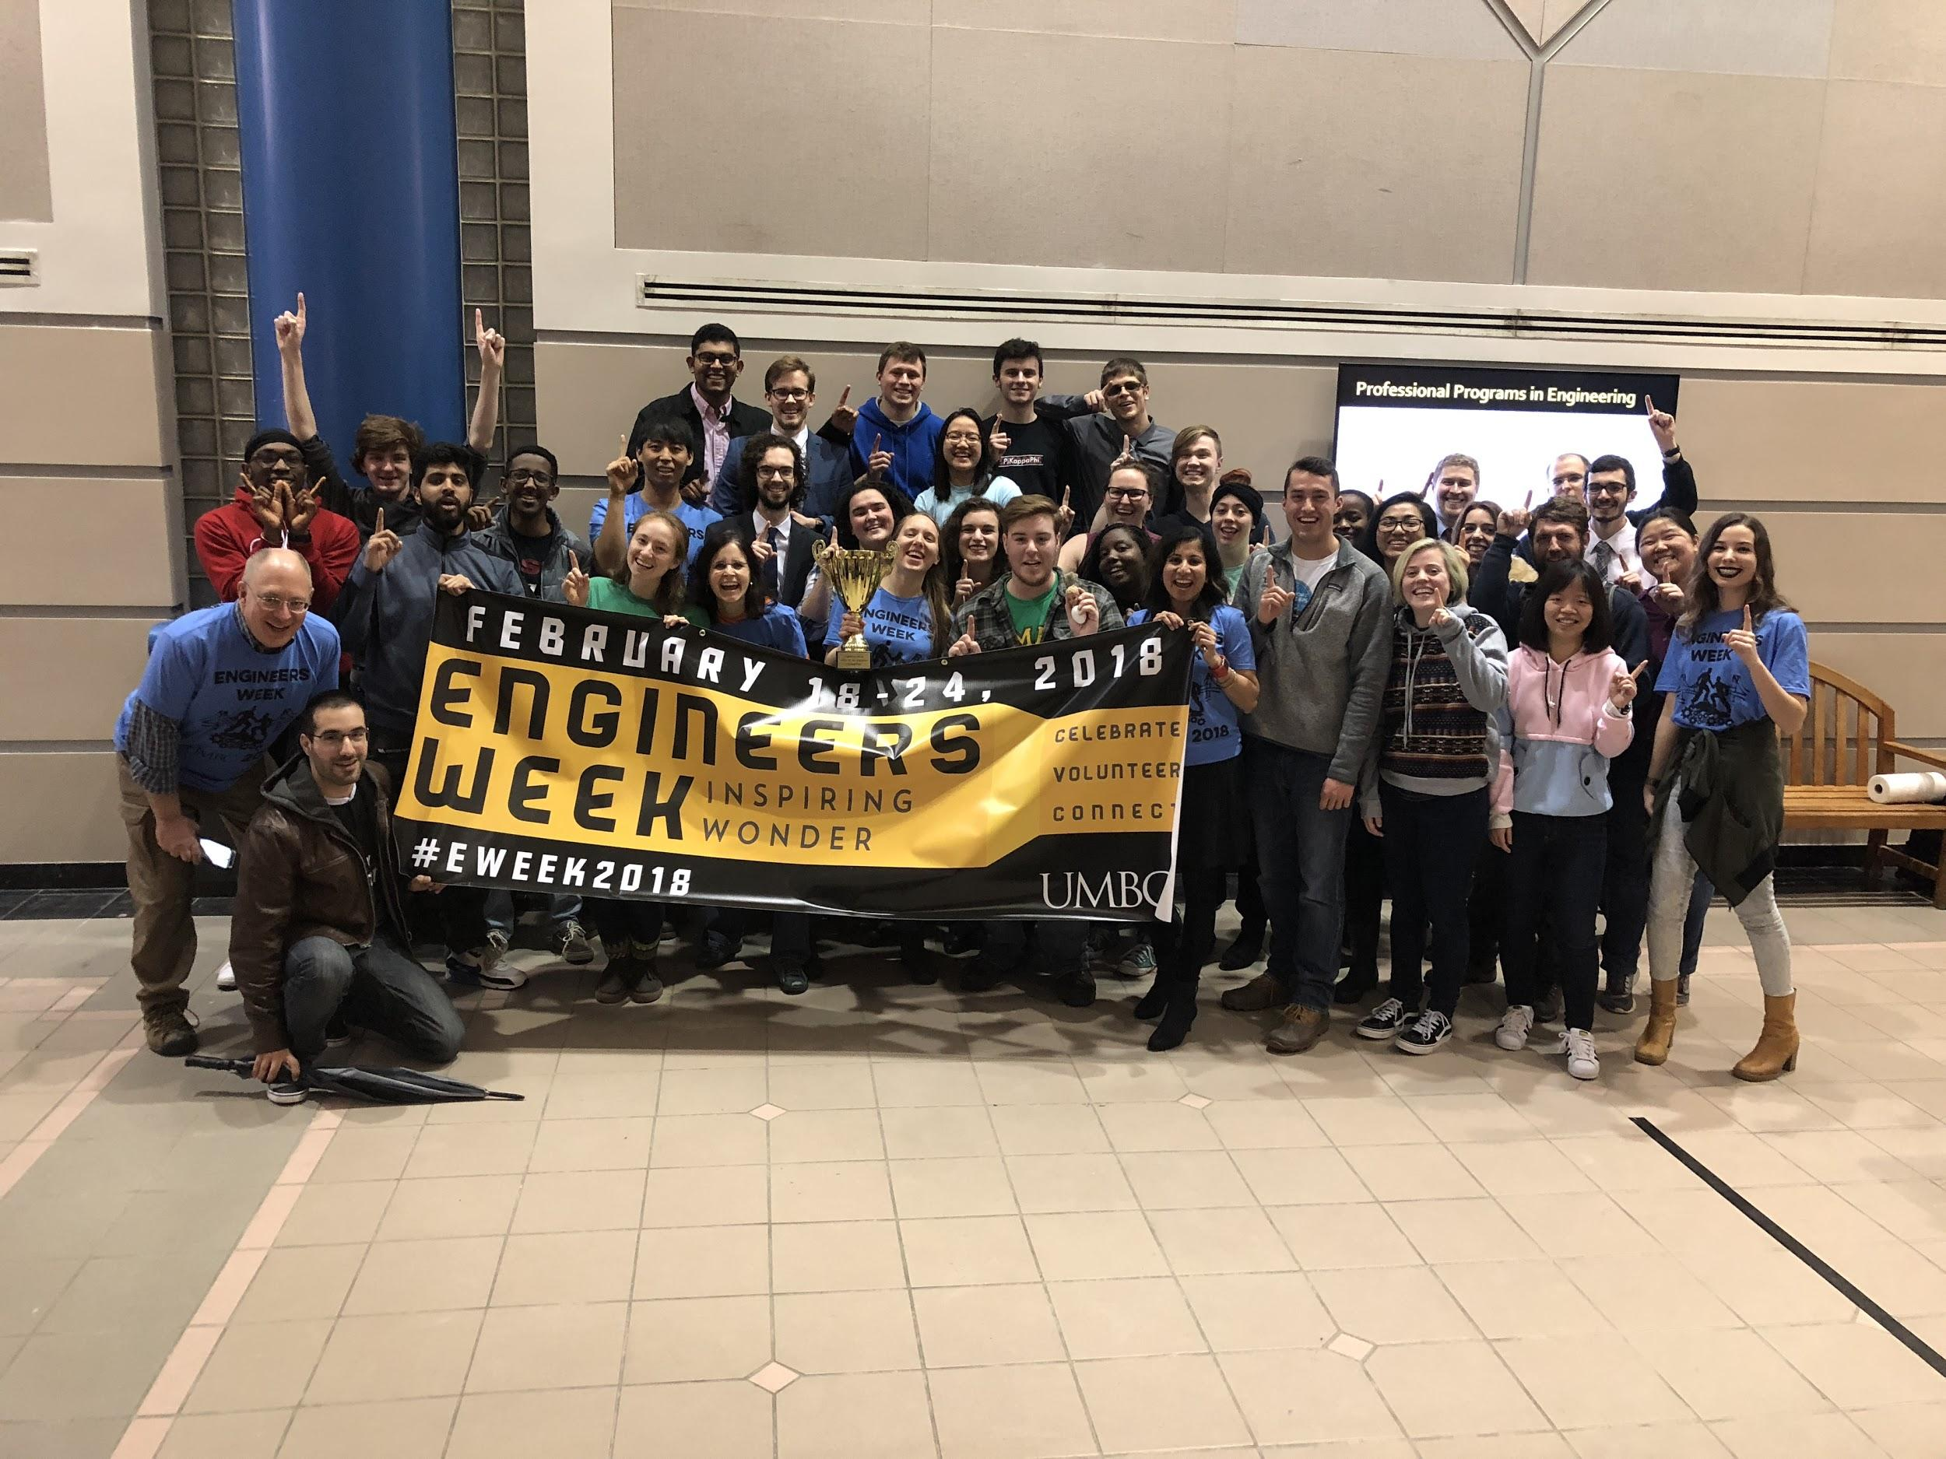
TBP at UMBC
More active than ever - over 80 members
Hosts Annual National Engineers Week celebration!
Collaborate extensively with other COEIT Orgs
Opportunities for tutoring and youth outreach

Slide 5
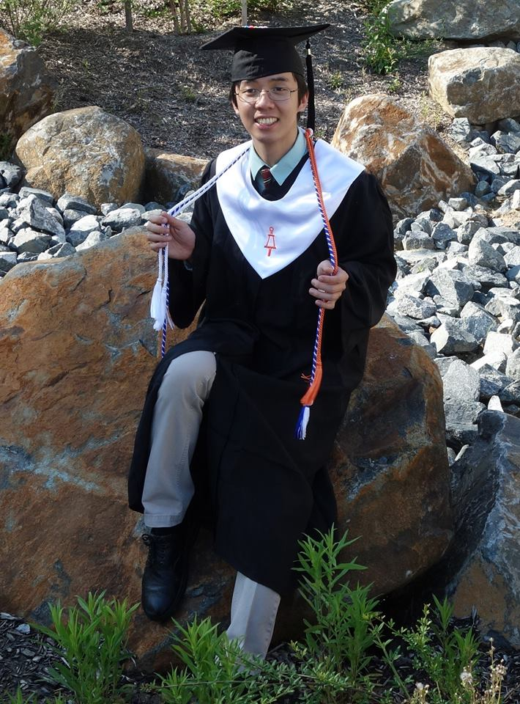
More Incentives
Lifetime membership and distinguishment
Stole at graduation, bent, certificate
Free monthly subscription to The Bent
Food and friends at GBMs and cookouts

Slide 6
Requirements for Initiation
5 hours of social activities
5 hours of service activities
Polish ‘The Bent’ (in front of ITE)
Member Signatures: get signatures from 3 TBP professors and 5 current TBP members
One time $85 initiation fee

Slide 7
Important Dates
Next GBM: THIS Friday November 9th -12pm (ITE 102)
Bent Polishing: TBD
Initiation: Saturday, Dec 1st (morning)

Slide 8
Service Opportunities
11/10 @ 12pm: Patapsco trail clean up
11/18 @ 12-1pm: Garden day
CRU Baltimore Community Tool Bank - every friday at 1pm-4pm
Any previously completed service from this semester will also count
Tutoring

Slide 9
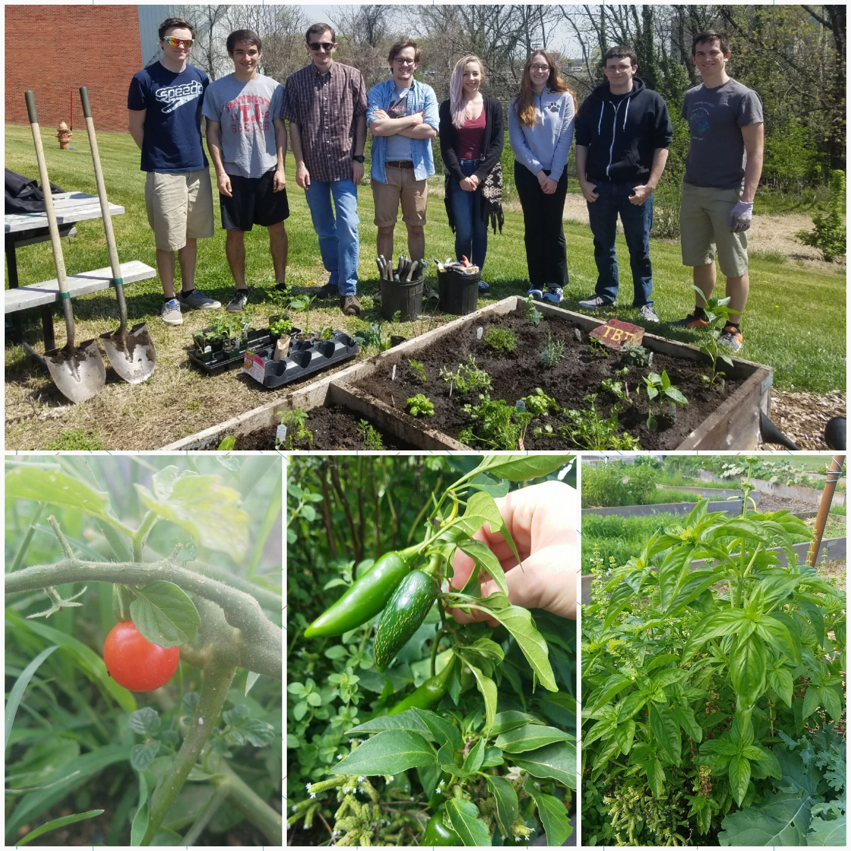
Tutoring & The Garden
Sign Up for Tutoring: Click Here
CMPE 212
ENME 110, ENME 220
ENCH 225, ENES 101
Email Chris at christ36@umbc.edu with questions!
The Garden (Social or Service Hours!)
Friday April 13th @ 12pm
Sunday April 22nd @2pm

Slide 10
Social Opportunities
Tentative) 11/16 @ 5-7pm : Thanksgiving ~event~
Food: baked goods, pie, pizza
Offer extra social for bringing baked good
11/19 - Fundraiser
11/9 - This GBM counts as 1 social hour
11/9 @ 7pm, 11/15 @ 8pm Movie night
(Tentative) Ice skating ⇒ indoor rink in Columbia, outdoor rink in Baltimore
Offer free admission (pay for everyone using TBP funds)
11/30 @ 5pm - Laser Tag

Slide 11
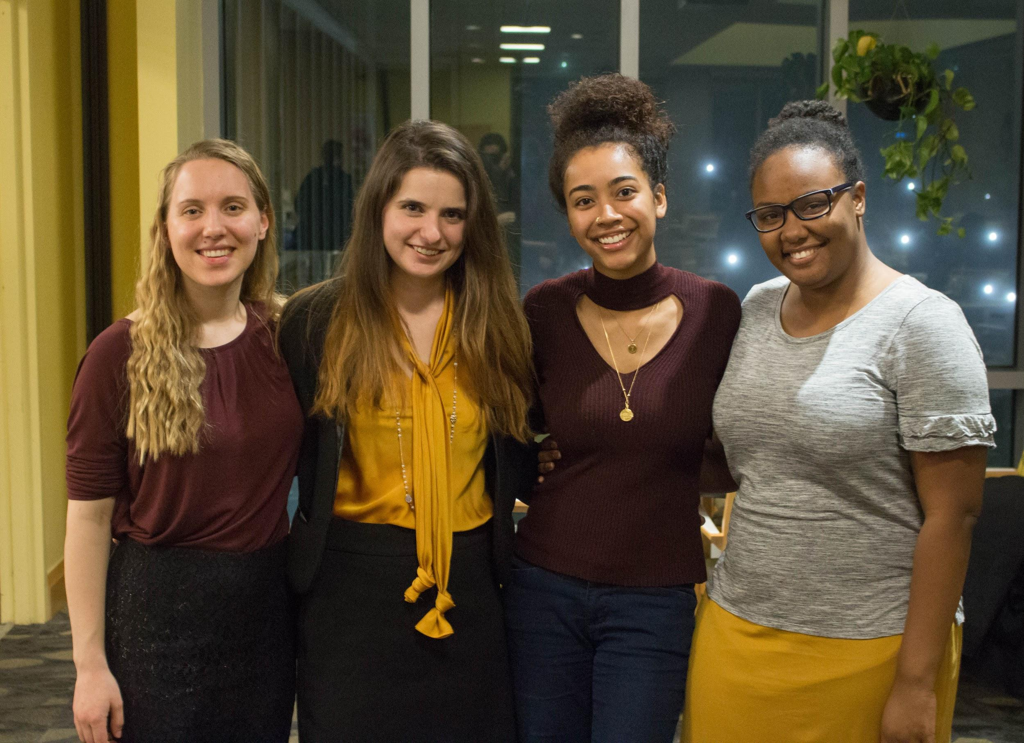
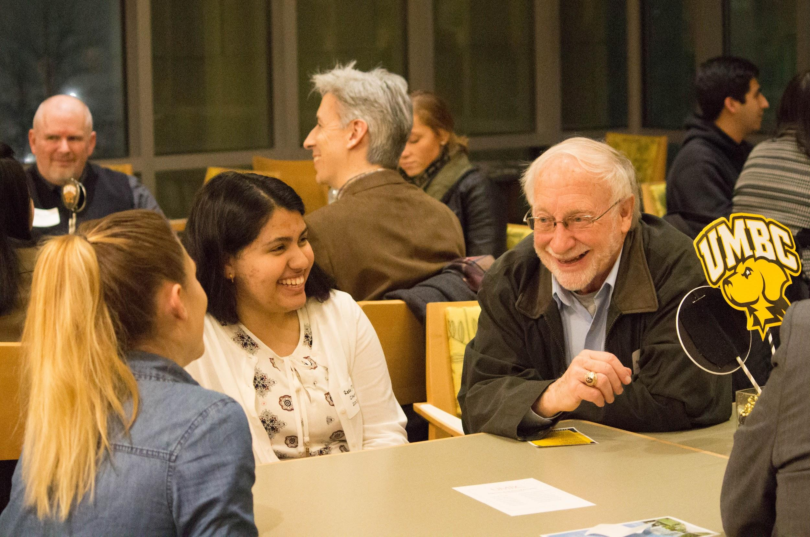
Engineers Week!
Tau Beta Pi hosts the Annual Engineer’s Week at UMBC!

Slide 12
What To Do Now
Come to GBMs (every 3 weeks)
Service & social events, bent polishing and TBP Signatures
Catalog Cards
Pay attention to your emails!
Send any questions to tbp.delta.umbc@gmail.com

Slide 13
Questions??

