Slide 1
Tau Beta Pi GBM #2
October 18, 2019

Slide 2
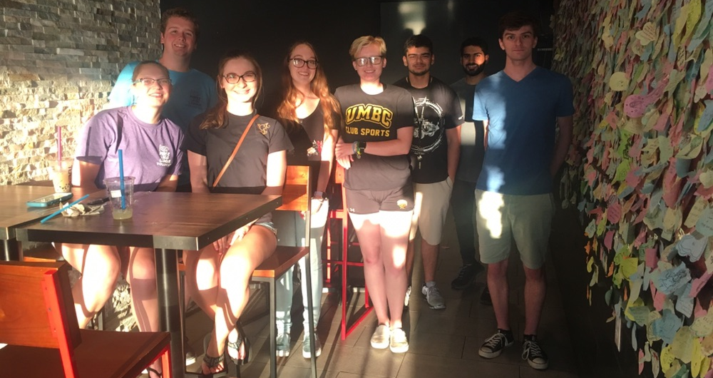
Upcoming Events
Social
Bubble Tea: October 25th 5:30pm @ Tea-Do
National Science and Technology Medals Foundation: Artificial Intelligence Panel and Events
  RSVP Here: https://www.nationalmedals.org/stories/aiumbc
  October 29th and 30th
Service
Trail Cleanup October 19th
Garden Workdays - TBD

Slide 3
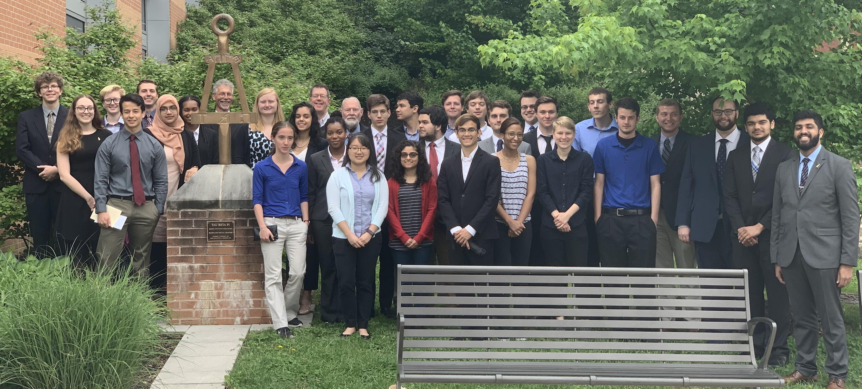
Initiation
December 7th: ITE 102 - arrive by 9:45 am
Required for active status!
Anyone that wants to help out is welcome!

