Slide 1
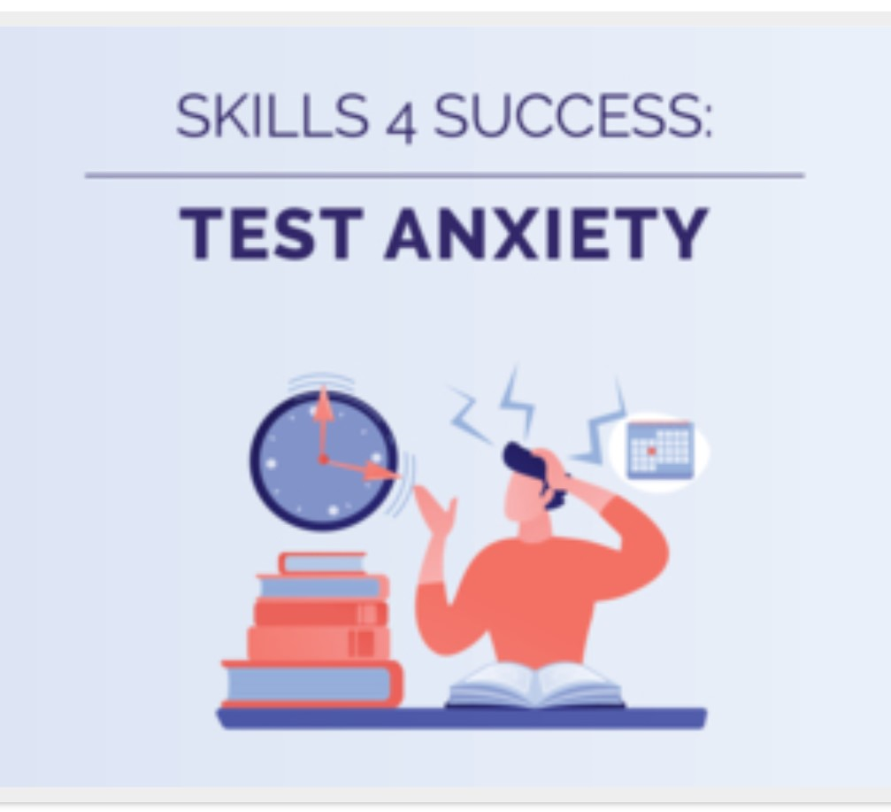
I: Procrastination
II: Stress Management
III: Time Management
IV: Test Anxiety
V: Motivation
VI: Getting Through Finals
Presenter: Ishita Sunita Arora Moderator: Helen Ding
UMBC Counseling Center

Slide 2

Let’s get to know each other…
What do you do for good luck before tests?

Slide 3
Objectives
Identify if you struggle with test anxiety
Learn the signs of test anxiety
Learn how to cope with test anxiety
Understand the causes and cures for text anxiety
Learn techniques to help you deal with test anxiety

Slide 4
Current context
You are not currently engaged in online distance learning. You are engaged in emergency remote learning during a global public health crisis.
Your performance this semester may not be the same as it would be under normal circumstances.
Focus on what you can control and use the information discussed today to help.
The Counseling Center is also here to help! 410-455-2472

Slide 5
UMBC Counseling Center Resources
This workshop is not therapy.
The counseling center is providing services remotely, including:
  Individual support via phone and video
  Tele-outreach through webinars and online workshops
Please visit https://counseling.umbc.edu/ for details
Phone: 410-455-2472

Slide 6

WHAT IS Test Anxiety ?
Psychological condition where the person experiences distress before, during, or after taking an exam to such an extent that this distress impacts the person’s performance or interferes with their learning.

Slide 7
Your test preparation experience…
How do you prepare for a test?
When do you start preparing for a test?
What does a typical day before a test look like for you?

Slide 8
Test anxiety in your own words…
In what ways do you feel distress around tests?
How does test anxiety impact your performance?
What have you tried to do to lessen your test anxiety? Has it been helpful, why or why not?

Slide 9
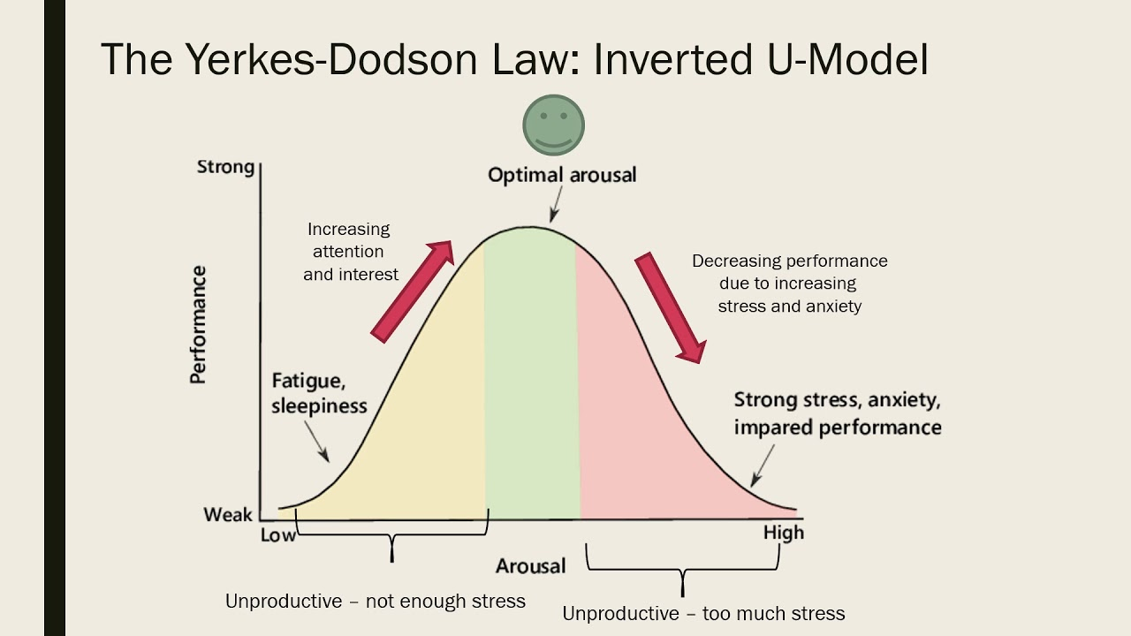
Some TEST ANXIETY can be beneficial

Slide 10
Symptoms of Test Anxiety
Physical | Emotional | Behavioral | Cognitive
Headache | Fear | Fidgeting | Racing thoughts
Nausea/GI upset | Disappointment | Pacing | Going blank
Body temp changes | Anger | Substance use | Difficulty concentrating
Sweating | Depression | Avoidance | Negative self-talk
Shortness of breath | Crying or laughing |  | Dread
Light-headedness | Helplessness |  | Peer comparison
Rapid heartbeat |  |  | Scattered thoughts
Dry mouth
How do you know when you are feeling anxious?

Slide 11
Causes and Cures for test anxiety
Causes | Cures
Unfamiliar with test | Learn about the test
Unfamiliar with material | Make a study schedule and use it
Negative thoughts | Counter w/ positive thoughts & actions
Test myths | Review myths vs. facts
Physical anxiety (“body playing tricks”) | Physical self-care
Tension builds up | Tension-relieving activities/exercises
Test environment is irritating | Tune out distractions
Mind draws blank or wanders | Stay focused
Test Anxiety Inventory: https://academic-success.phsc.edu/sites/default/files/documents/test-anxiety-inventory.pdf

Slide 12
POLL: How do you feel distress around test?
I often feel physically panicky when I have to take a really important test.
People will question my ability if I do poorly.
Aside from what others may think of me, I am concerned about my own opinion of myself if I do poorly.
Knowing that my future depends in part on doing well on tests upsets me.
Getting a good score on one test does not seem to increase my confidence on other tests.
One of my problems is not knowing exactly when I am prepared for a test.
During tests, I sometimes get so nervous that I forget facts I really know.
Room noises (from lights, heating/cooling systems, other test-takers) bother me.

Slide 13
Learning about the test
How many questions are on the test?
What format are the questions in (for example, multiple choice, short answer, etc.)?
How much time do you have to take the test?
How are your answers scored (should you write in essay format)?
What material is covered in the test?
What do the questions look like?

Slide 14

Reviewing the material
Create a study plan that outlines…
  What you are going to study.
  Where you are going to find helpful resources.
  When you are going to take each step.
For the test you should…
  Have a good understanding of important terms and concepts.
  Be able to define them in your own words.
  Be able to explain why they are important.
Notes:
How do you prepare for a test?
When do you start?

Slide 15
Countering Negative Thoughts
Negative Thought | Positive Thought
I always do poorly on tests | I have got a better study plan for this test than I ever have before
If I don’t pass this test, I am a failure | I am going to pass, but if I don’t, I can bounce back
I am not a good online student | I did not sign up for an online class; I am doing my best during a global emergency
What are your typical negative thoughts about tests ?

Slide 16
Myths vs. Facts
Myth: If you fail, you wasted your time.
Fact: Nothing is wasted if you tried your best.
Myth: This exam could out you as a phony. (Imposter Syndrome)
Fact: You were already accepted into UMBC for a reason. This exam is about demonstrating your knowledge of this particular material.
Myth: You should study everything all the time.
Fact: That would be inefficient. Focus on what was discussed in class and assigned for homework. Pay special attention if it was mentioned more than once or was written on the board/included in a PowerPoint.

Slide 17
Self-care
Eat, sleep, exercise
1
Plan and take study breaks
2
Maintain social connections
3
Surround yourself with positive support
4
How do you engage in self-care before the test?
How has COVID-19 changed this?
Notes:
Eat well and exercise.
•Studies have shown that lack of sleep can contribute to memory loss and lack of concentration. So get plenty of sleep, especially the night before the exam.
•Continue to socialize with friends and family and take regular study breaks. You emotional health is as important as your physical health for minimizing anxiety.
4•Surround yourself with positive people who support your studying and desire to do well. Try to avoid friends or acquaintances with negative attitudes, especially negative attitudes about studying.

Slide 18
Tension-Releasing Activities
Deep breathing
Guided imagery
Progressive muscle relaxation
Specific Context -
What have you tried to lessen your anxiety?
Has it been helpful?
Notes:
If you feel very anxious in the exam, take a few minutes to calm yourself down. Stretch your arms and legs and then relax them again. Do this a couple of times. Take a few slow deep breaths. Do some positive internal self-talk; say to yourself, “I will be OK, I can do this.” Then direct your focus on questions; link questions to their corresponding lecture and/or chapter.
When you start feeling anxious, take a couple of long, deep breaths and exhale slowly. While you do this, it may help to close your eyes and imagine a peaceful setting, such as a quiet tree-lined pond, or a beautiful ocean beach.
•When you feel you body tensing up, focus on a particular group of muscles (e.g. the shoulders or back), and first contract them for about 10 seconds and then allow them to relax. Concentrate on the difference in the feelings and repeat the exercise trying to get the muscles to relax more each time.

Slide 19
Tuning out Distractions
Plan a time to take the test when others are less likely to interrupt/distract and also when internet bandwidth will not be stretched thin
Find a quiet, private space and put a sign on the door/notify others that you are taking a test
Avoid chatting with others leading up to the exam. Anxiety can be contagious!
Have a strategy for dealing with distraction, e.g. telling yourself “remain calm”
Notes:
Other strategies?

Slide 20
Staying Focused
Do not start answering write away. Review the test to avoid surprises. Begin with the high-value test questions.
Prepare mentally that you will not be 100% sure of every question and that is OK.
If you draw a blank, action fights anxiety. Start writing down anything that comes to mind on scratch paper. Ideas may come, you may get partial credit.
For MC questions, answer the easy ones first and go back to the hard ones. Do not spend too much time on any one question; answer every question (if no penalty).

Slide 21
Find an accountability partner for test prep
This can be a classmate, friend or relative
With your coach make a list of all the fears you have about the test and about test taking in general. Next to each fear, write down the specific steps you will take to help you conquer that fear. For example...
FEAR | STEPS
I’m going to freeze up during the exam. | 1. I will take the practice test, timed, once a week until the test. 2. I will practice relaxation techniques prior to taking the test. 3. I will use relaxation techniques to help relieve tension during the test

Slide 22
POLL: One strategy that you can commit to today?
Self-care
Tension-releasing activities
Maintaining and/or increasing focus
Identifying the source of my test anxiety
Countering negative thoughts

Slide 23
Q & A
Remember...Test anxiety feeds on the unknown; the more you know about the test, about yourself, about your anxieties and how to conquer them, the less the test anxiety will control you.
Good Luck!!
Notes:
When the exam is over, treat yourself. If you don’t have any other commitments, maybe you can go to a movie with a friend. If you have to study for other exams, you may have to postpone a larger break, but a brief break can be the pick up that you need.

Slide 24
Resources
Counseling Center:
During office hours (M-F, 8:30-5pm): 410-455-247
After-hours Support Line: 410-455-3230
https://welltrack.com/
COVID resources: https://counseling.umbc.edu/resources/covid-19-resources/
UMBC Tech Support: (410) 455-3838, https://my.umbc.edu/help
Academic Support: https://academicsuccess.umbc.edu/asc-business-continuity/
NAMI COVID-19 Resource Guide: Resources organized based on 12 questions for vulnerable populations
https://www.nami.org/covid-19-guide
211.org: Search for resources to meet essential needs (e.g., food pantry)
http://211.org/services/essential-needs

Slide 25
Crisis Resources
National
Phone:
Suicide Prevention Lifeline: 800-273-TALK (8255)
Domestic Violence Hotline: 1-800-799-7233;
https://www.thehotline.org
Text/Chat:
Crisis Text Line: Text HOME to 741741
IMAlive Crisis Chat: www.imalive.org
Lifeline Crisis Chat: https://suicidepreventionlifeline.org/chat/
Local
Nearest Psychiatric Emergency room is St. Agnes:
900 S. Caton Ave. Baltimore, MD 21229
(Tel: 410- 368-3494)
Maryland Crisis Hotline (24/7): 1-800-422-0009
Baltimore County Crisis Response Community Hotline: 410-931-2214
Grassroots Crisis Intervention Telephone Hotline: 410-531-6677
Please see our website for additional information: counseling.umbc.edu/services/crisis/

Slide 26
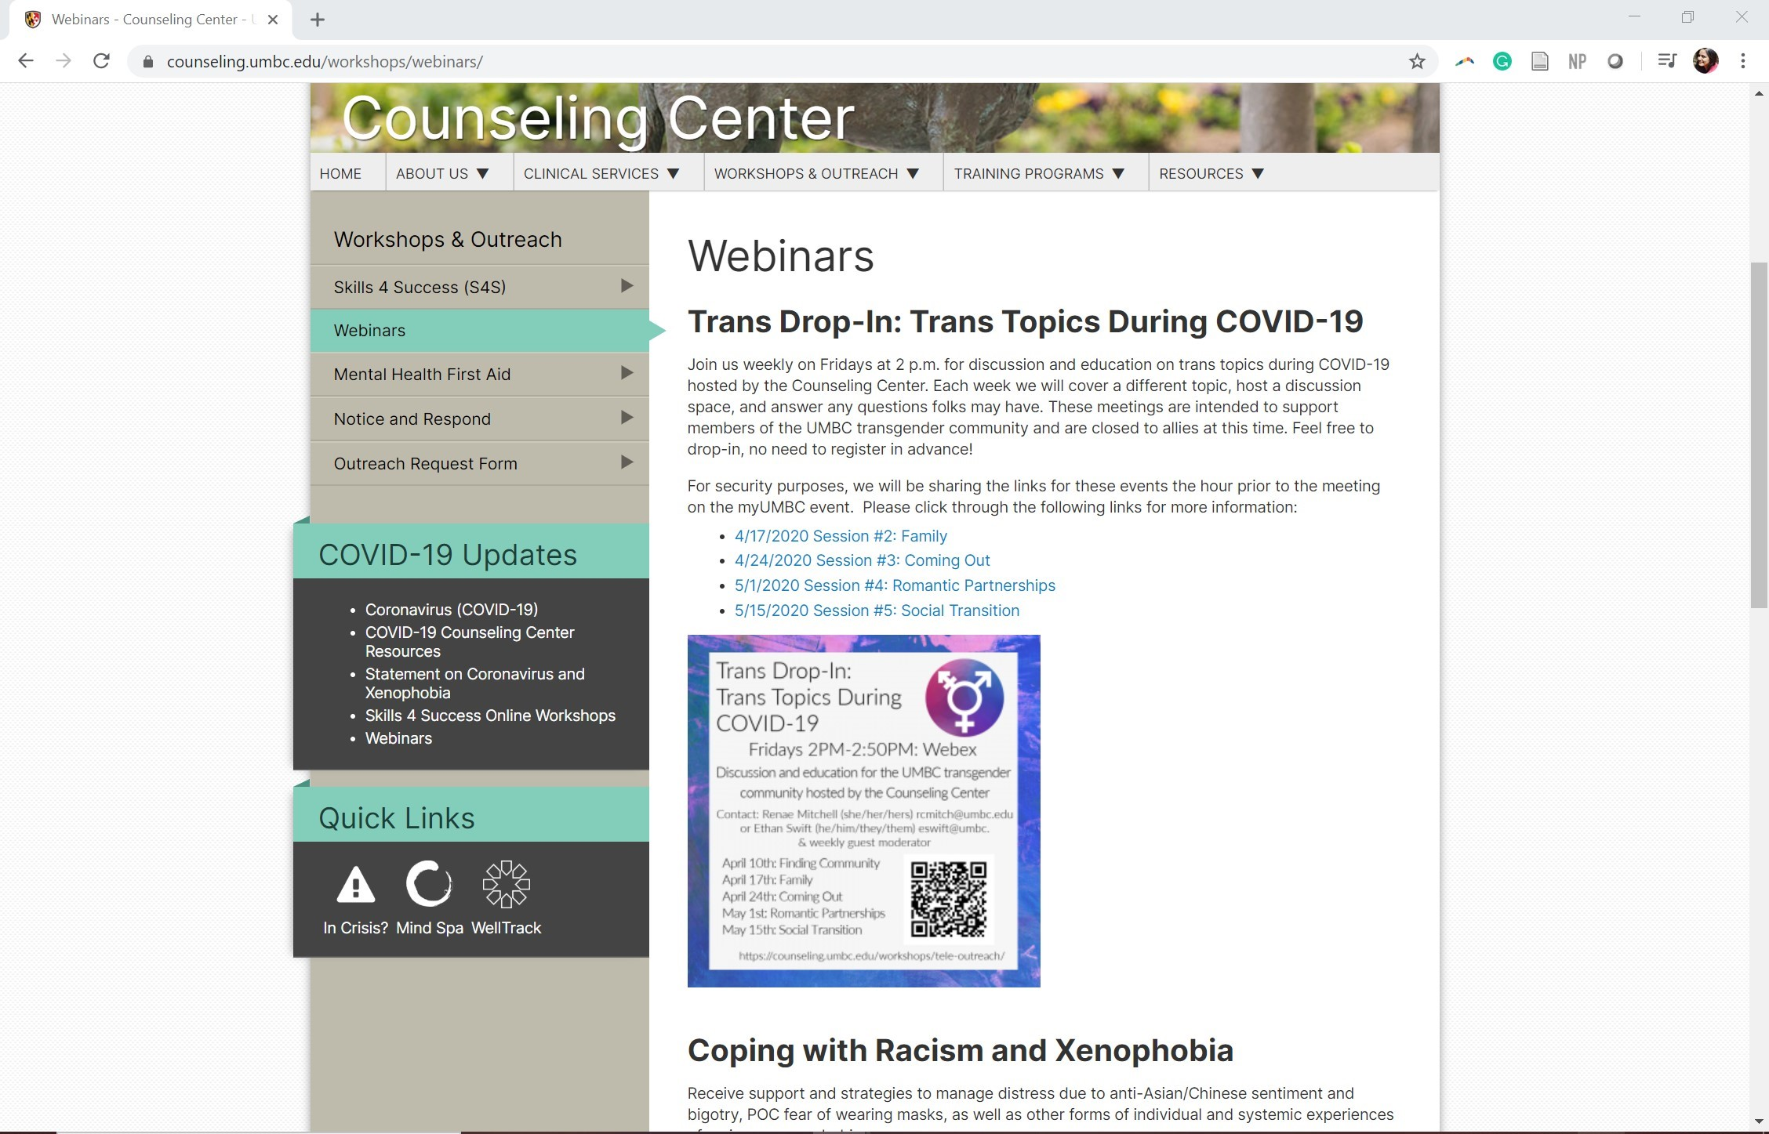
Future Webinar Reminders
Skills 4 Successful, Session #3 Time Management, Wednesday, May 6, 2020 at 12:00 PM - 1:00 PM --- New Webinar Link on myUMBC !
Sign-Up for Counseling Center Webinars here : https://counseling.umbc.edu/workshops/webinars/

