Slide 1
Axient / Systems Engineering Group (SEG)
AIAA Brief
Engineering for a Complex World
November 2022

Slide 2
Agenda
Introductions
  AIAA Participants
  SEG Participants
Goal of Coming to the AIAA Meeting
Axient / SEG Overview
Employee Skill Sets we typically Search
BMDS Overview and Systems Engineering
Contact Information

Slide 3
Goal of Coming to the AIAA Meeting
AIAA member since ….. Share experience
SEG – Campus Relationship building
Share some Systems Engineering experiences
Share some challenging problems that need solving
Provide Company information for potential hires / interns
Answer questions –help you in your career path job pursuit
SEG has current interns and fulltime employees that were interns

Slide 4
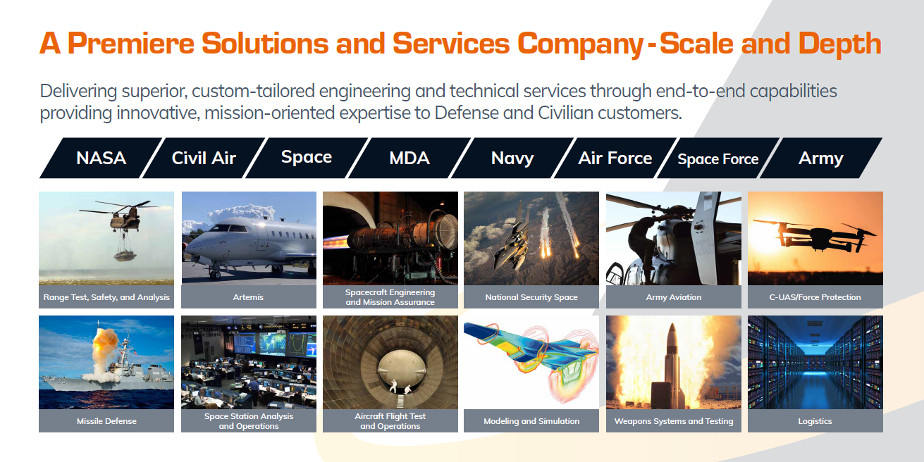
UNCLASSIFIED

Slide 5
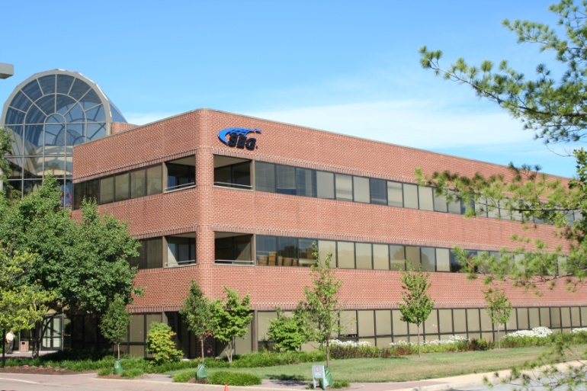
SEG Background
Founded in 1991. Headquartered in Columbia, MD
  A wholly owned subsidiary of Axient Corporation (2022)
TS Facility clearance with SIPRNET, and access to all-source intelligence processing facilities
  Supports threat-driven system analyses
  Field offices in Dahlgren, VA, Mt. Laurel, NJ, Colorado Springs, CO and Huntsville, AL
Highly regarded and experienced provider of
  Integrated Air and Missile Defense Threat Engineering
  Combat Systems and RADAR engineering and analysis
  Missile systems engineering
  Software engineering and development
  Combat System ship integration
  Acquisition and Program Management support services

Slide 6

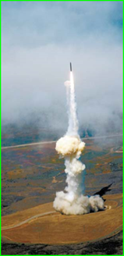
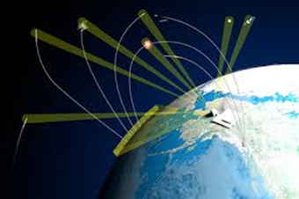
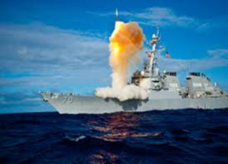
SEG Overview
Our Mission: Provide superior, holistic, physics-based engineering grounded by Intelligence
Modeling & Simulation Tools
Intelligence Analysis
Threat System Engineering and Modeling
Expert Systems of Systems Engineering
Sensor Prototypes, Software, Algorithms & Models
Missile M&S from Component to All-Up Round
US and Foreign System Experience
Highly specialized Scene Generation and M&S products for R&D labs, DoD, industry and war-fighters
Threat Engineering
System Engineering
Sensor Engineering
Missile Engineering

Slide 7
Our Engineering and M&S Focus Area
Strategic/Policy
Operational/Campaign
Tactical/Mission
System/Subsystem
Science/Phenomenology
Trusted Company with Multiple DoD and Public Customers Including the Missile Defense Agency, NASA, and U.S. Navy

Slide 8
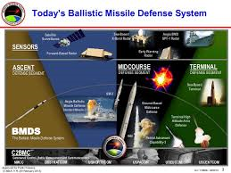
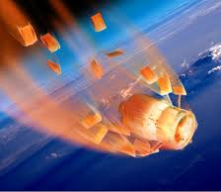

Modeling and Simulation Capabilities
Flight Analysis Simulation Trajectory
High fidelity 6 DOF Monte Carlo launch-to-impact simulation developed to represent missile systems for MDA and U.S. Navy. Provides comprehensive flight representation of unitary through multi-stage complex missile systems including hypersonic vehicles.
DebrisSim
Monte Carlo Debris simulation representing missile pre/post intercept and breakup debris. Easy-to-use interface enables radar, weapon system and missile system simulations to synthesize and interrogate missile debris scenes.
3D SCMs
Provides continuous RF signatures in aspect, roll, frequency and polarization in a format ten times smaller in size and accuracy than current industry products. Models are extendable to Monte Carlo techniques for treatment of intelligence uncertainties and when used with HWIL Radar Scene Generation.

Slide 9
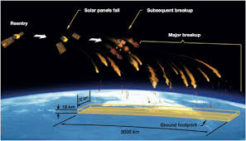
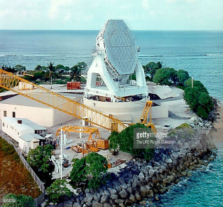
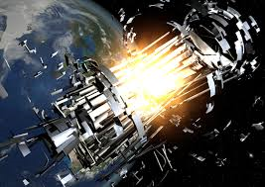
Modeling and Simulation Capabilities
TMCAT
An innovative, high fidelity, fast running, first-of-its-kind simulation that synthesizes a complete missile radar scene including principle objects, debris and corporate clutter. Simulation is extendable to X-Band and other frequency bands.
Radar Environment Stimulation - REST
Provides high-fidelity, real-time RF scene stimulation via analogue or digital signals that include real world environments for test and evaluation of signals processors. REST, when not interfaced with a specific radar, can be employed as a stand-alone development station.
SEGRAP, ATHENA, NEMESIS
High functioning, reconfigurable radar and system models that are pushing the industry standard.

Slide 10
SEG Hiring and Culture Overview
SEG develops and uses industry-leading models and analysis tools
SEG provides Air, Land, Sea and Space systems precision engineering as well as expert management support
Small company atmosphere with large company stability
Friendly, smart, innovative people
Hiring the right people to help continue what we started
Very competitive salaries and benefits
Other Disciplines
  CAD and Computer Drawing
  Computer Programming
  Software Engineering
  Electronic Hardware and RF Design
  Combat System Engineering
  RADAR Engineering and Analysis
  Algorithm Development
  Fundamental Research
  Electronic Warfare
All aerospace related disciplines:
  Aerodynamics (CFD)
  Guidance and Control Systems
  Propulsion and Flight Dynamics
  Aerothermal Analyses
  Mechanics of Aerospace Materials
  etc.

Slide 11

www.axientcorp
Phone: 410.381.8740
SEGjobs@SEGmail.com

Slide 12
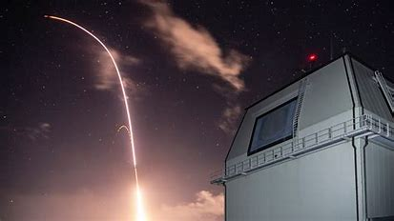
Ballistic Missile Defense System (BMDS)
101 Brief
November 2022
Systems Engineering Group

Slide 13
Agenda
Systems Engineering “V”
BMD Proliferation
Budgeting
MDA History
BMD and Ballistic Flight Basics
Near Peer Threats
BMDS Overview Slide
BMD Basics – Launch – Midcourse – Terminal
BMD Weapons (Navy)
BMD Sensors
BMD Shooters / Weapon Systems
BMD Review Holistic & Command and Control Approach
Summary

Slide 14
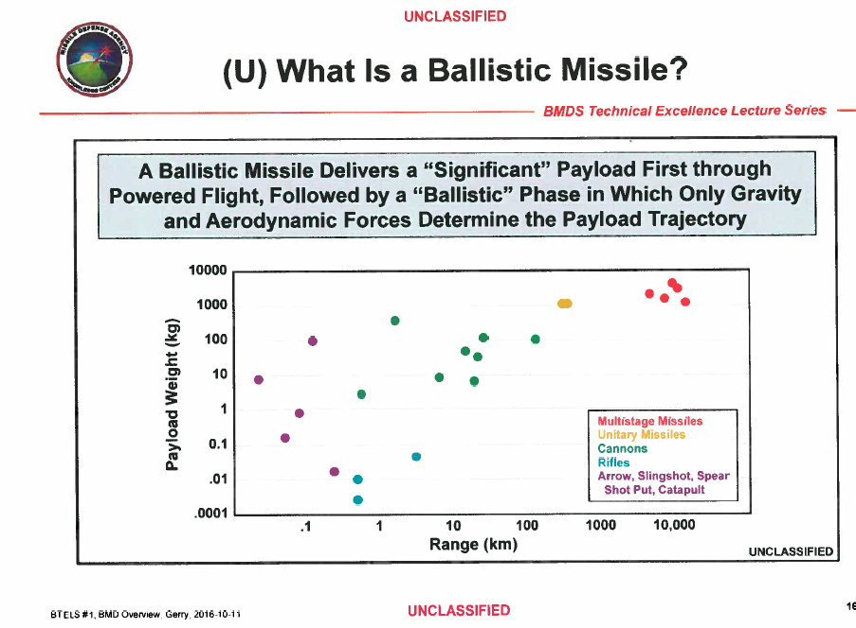
Ballistic Weapons
What goes up – must come down – for now

Slide 15
Ballistic Flight Path and Variables
Nominal Speeds of Mach 5
  3800mph or 6200kph
Hypersonic Glide Vehicles (HGV)
Multiple Independently Targeted Reentry Vehicle (MIRV)
Maneuvering Reentry Vehicles (MaRV)
Countermeasures (jammer, flares, decoys)

Slide 16
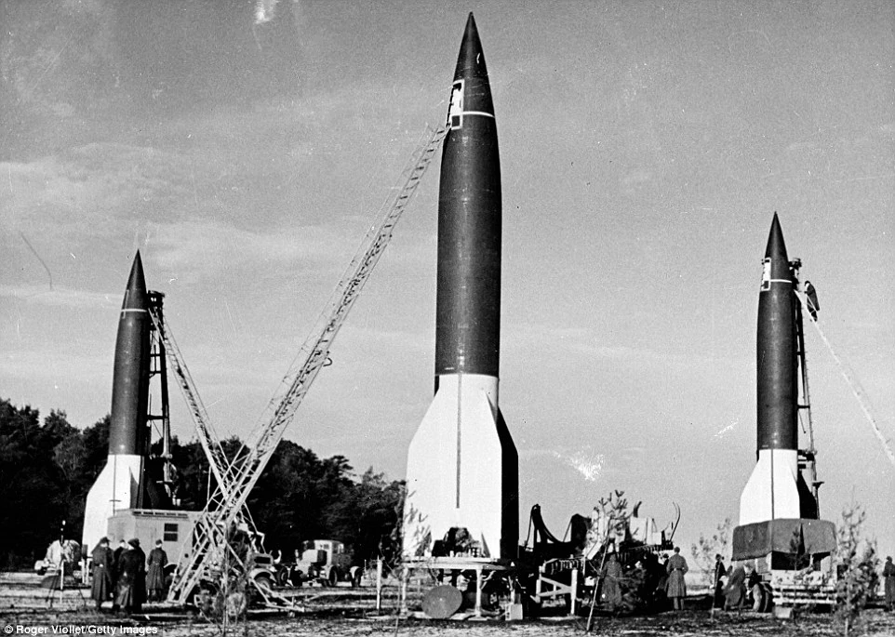
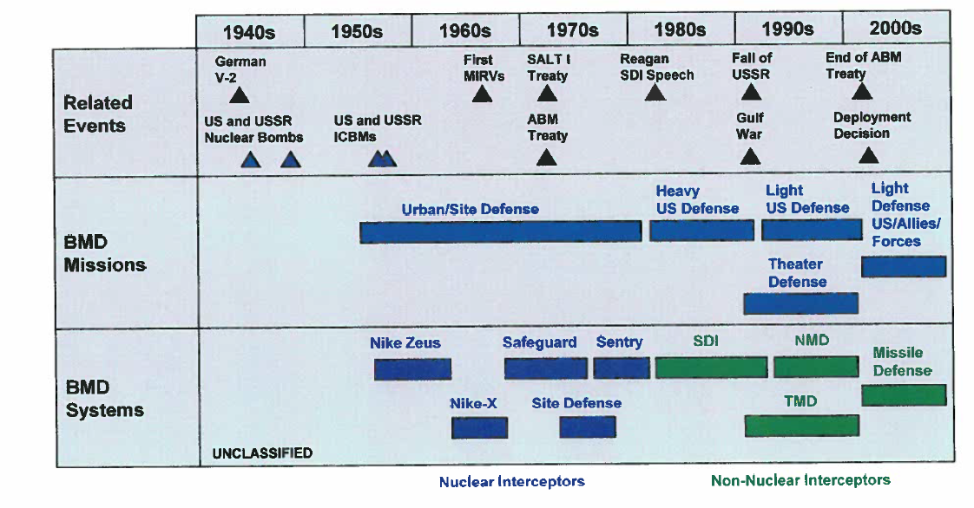
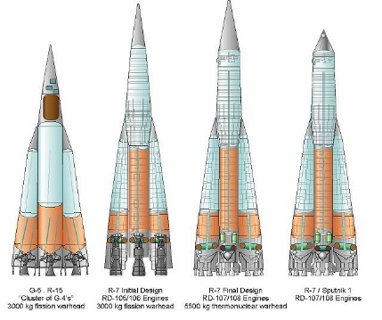
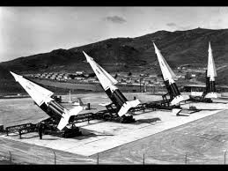

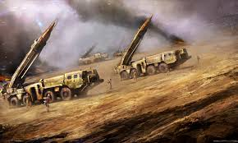
History

Slide 17
BMD – So What?
Advancements: 1942 ~ 320km → 2022 ~ 16,000km

Slide 18
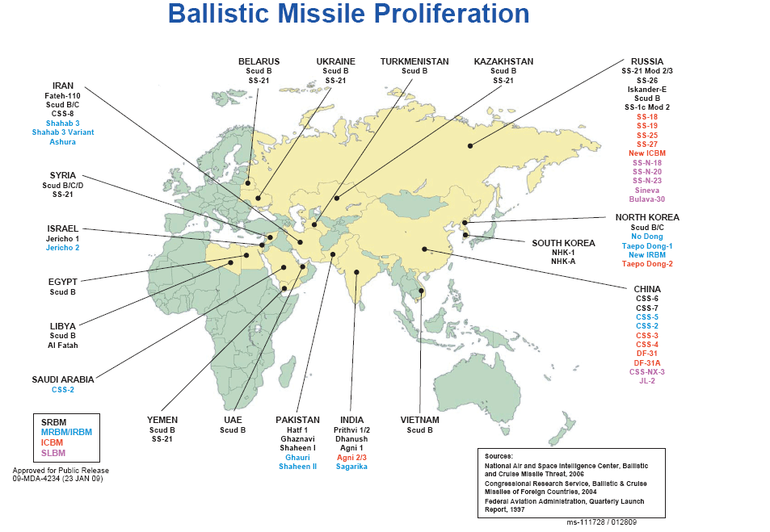
BMD Proliferation

Slide 19
Example of Threat Systems from Various Countries

Slide 20
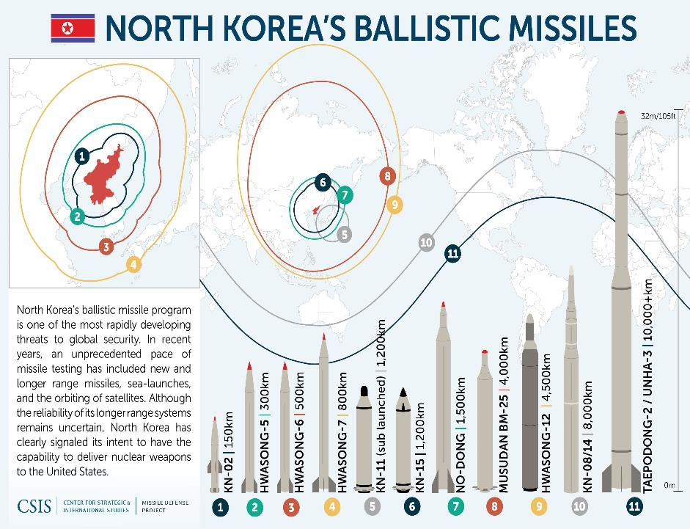

Slide 21
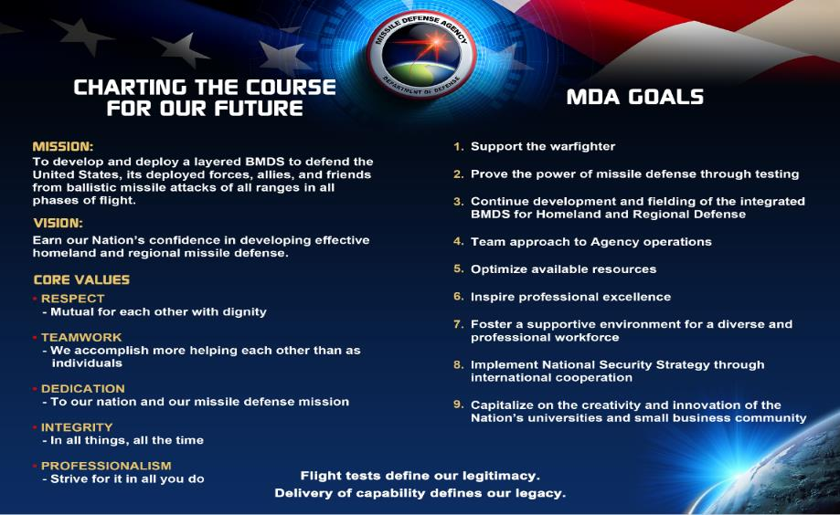
Missile Defense Agency

Slide 22
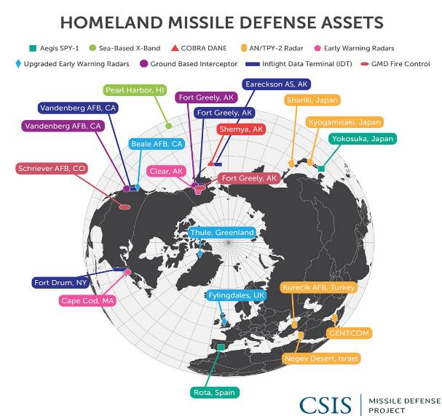
FY 22 Budget
$20.3 billion for Missile Defense across the services and MDA
  ~ $8.9B for MDA of which ~ $7.2B is for R&D
  Layered defense of the homeland, deployed forces, allies, and partners
  Ground-Based Missile Defense
  Terminal High Altitude Area Defense
  Advanced Technology Missile Defense
  Aegis BMD and SM-3 Block IIA
  Hypersonic Defense
    Next Generation Interceptor

Slide 23
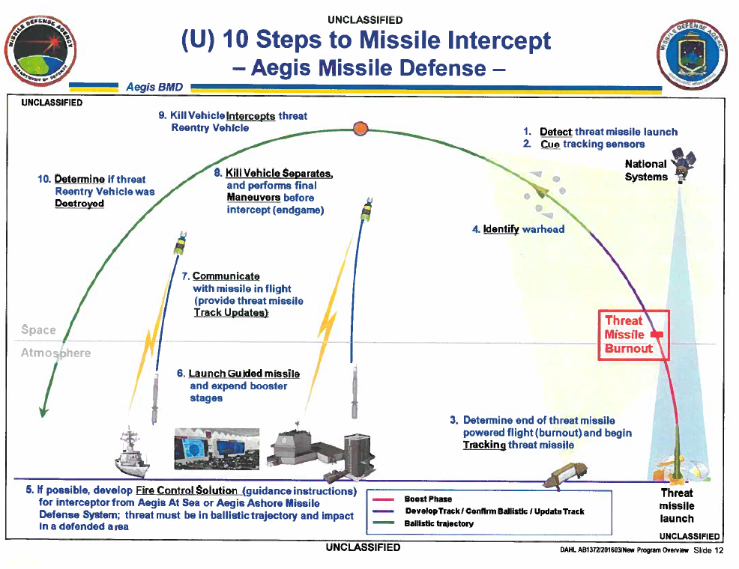
Steps to Aegis BMD Intercept

Slide 24
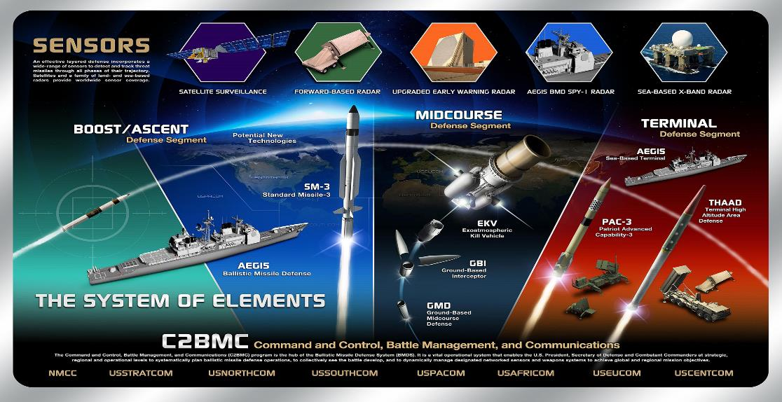
Ballistic Missile Defense System (BMDS)

Slide 25
Systems Engineering “V”
Feedback from Users V2
SCR
Plan
Deliver
Concept Analysis
Test
Rqmnts
Test
Assess
Exercises and Training
Systems Concept Review
Define
Assess
Train
Test
Plan
Test
Exec
Wargaming
SRR
Test
Ready
Performance
Assessment
BMD
System
Design
Test
&
Verify
SVR
Systems Requirements Review
Element
Engineering
System Verification Review
Element
Design & Build
Ground Test
PDR
tRR
Preliminary Design Review
Element Integration
Test Readiness Review
CDR
Critical Design Review

Slide 26
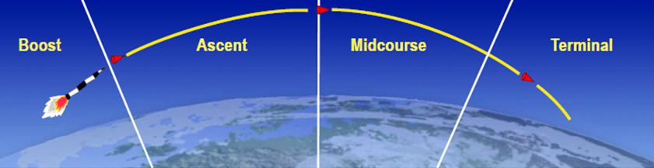
BMD Fundamentals

Slide 27
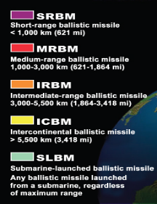
Layered Defenses
Midcourse
Altitude
Ground-Based Interceptor
Aegis BMD
Boost
Aegis BMD
Atmosphere
THAAD
Terminal
PAC-3
SM-2 Blk IV/
SM-6 Dual I
PAC-3
0
600
1,300
5,500
≈10,000
Range (km)
Short Range Ballistic Missile (SRBM)
Medium Range Ballistic Missile (MRBM)
Intermediate Range Ballistic Missile (IRBM)
Intercontinental Ballistic Missile (ICBM)

Slide 28
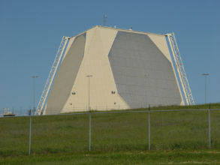
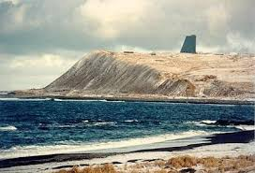
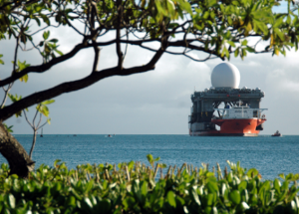
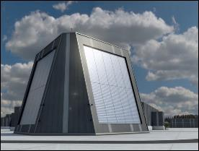

Missile Defense Sensors - Strategic
UEWR
Cobra Dane
SBX
LRDR
1953 –
5 Radars total
Starting in 1953
3 upgraded
2 more by upgraded by 2018
UHF band
3000 nm range
Stationary
1976 -
1 radar – Shemya Alaska
Phased array
Built in 1976
L band
2000 mile range
Stationary
AF Operated
2007 -
1 radar – moveable
X band
Tracks more than searches
Often located between Hawaii and Japan
Navy Operated
2500 mile range
~2022
continuous and precise tracking and discrimination of missile threats to the United States.
Discrimination is a critical capability of missile defense
Beale Air Force Base, California;
RAF Fylingdales, United Kingdom;
Thule Air Base, Greenland
Cape Code, MA
Clear, Alaska
The SBX-1 serves as the largest and most sophisticated phased array
electro-mechanically steered X-band radar in the world
Homeland Defense

Slide 29
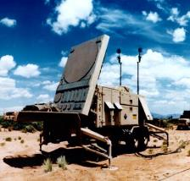
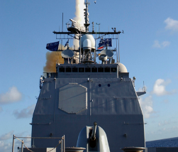
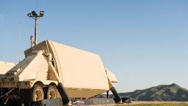
Missile Defense Sensors
FBX/TPY-2 /
Forward Based Mode X band
PATRIOT
SPY-1D
2007 - Current
Currently – 6 in BMDS
Transportable
X band
1,000 km range
Built by Raytheon
2000’s PAC-3 - current
1 radar – weapon system
AN/MPQ-53 C-band
Lower tier – footprint defense
Range: 100 km
Tracks 100 + targets
Primarily designed as a point defense. This means that they protect a specific asset or location, and are best deployed as part of a layered missile defense system.
1980’s - current
85 Aegis ships + 2 Aegis Ashore sites
S band
310 km
Produced by Lockheed Martin
Sea-based – mobile
Land-based – Aegis Ashore
Primarily for regional and homeland defense. Located in Europe, Israel, Guam, Japan and Qatar.
Point, Regional and Homeland Defense

Slide 30
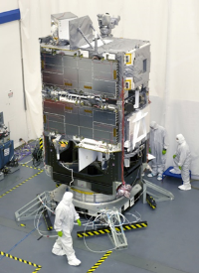
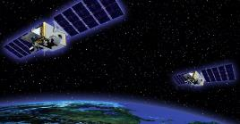
Missile Defense Sensors – Space Sensors
Space Tracking and Surveillance System (STSS)
Precision Tracking Space System (PTSS)
Space Based Kill Assessment (SKA)
2009 Launch -
2 vehicles in low earth orbit
Track threats
Northrup Grumman and Raytheon built
2 year experiment over – operational use continues until a follow on system exists
IOC 2018
Network of small sensors hosted on commercial satellites
Infrared sensors
Connected to BMDS command and control elements for tasking and reporting
- 2009 - 2014
Replacement to STSS
Cancelled in 2014
Prototype built by JHU/APL
PTSS was intended to employ a constellation of infrared sensors

Slide 31
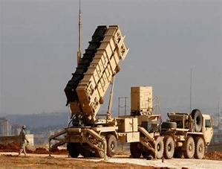
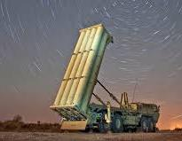

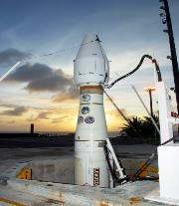
Missile Defense Shooters
Patriot
Terminal High Altitude Area Defense (THAAD)
Aegis BMD
Ground Based Midcourse (GBI)
2012 – Current
6+ batteries
50 + interceptors
THAAD battery has four main components:
Launcher
Interceptors (8/launcher)
Radar: AN/TPY-2
Fire Control
Produced by Lockheed Martin
Terminal + Regional Defense
2004 (BMD) – Current
33 BMD Aegis Ships
1+ Aegis BMD Ashore Sites
Aegis produced by Lockheed Martin
SM-3 missile produced by Raytheon
Mobile – 30+ knots (ship)
Vertical Launching System (96 cells for a DDG)
Terminal + Regional Defense
~ 2000+ – Current
2 Launch Locations
Composed of Ground-Based Interceptors and Ground Support & Fire Control Systems
Homeland Defense
~ 1990+ – Current
Mobile boxed interceptors and Ground Support & Fire Control Systems
Terminal + Point Defense

Slide 32
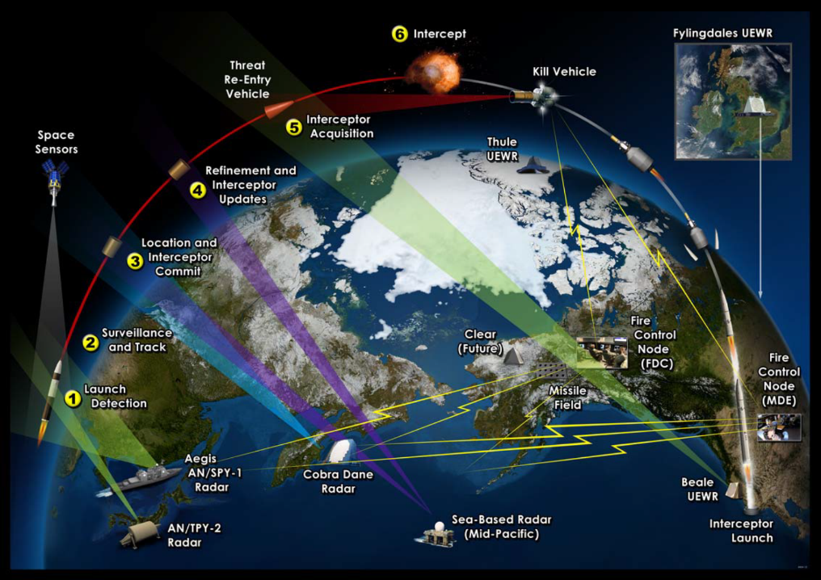
Full Detect to Engage

Slide 33
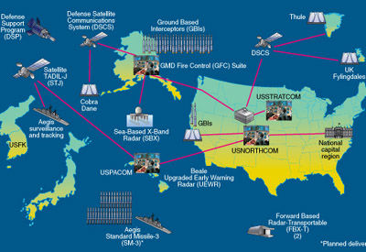
Command and Control

Slide 34

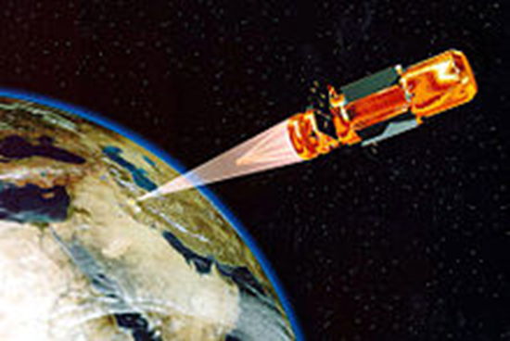

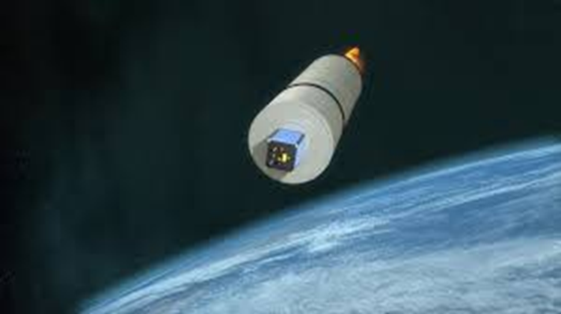
Future Challenges

Slide 35

Peace at Last – Questions?

