Slide 1
American Institute of Chemical Engineers
9.23.19
GBM #1
aiche@umbc.edu

Slide 2
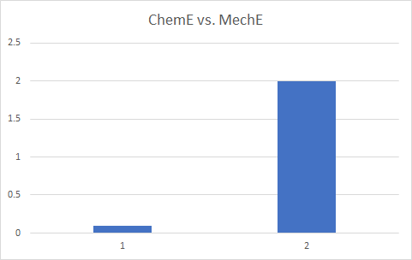
American Institute of Chemical Engineers
- AIChE was established in 1908 to distinguish chemical engineers as a profession independent of chemists and mechanical engineers.
degree of cool
- 45,000 members in over 150 countries
- President: Kimberly Ogden, University of Arizona
MechE
ChemE

Slide 3
AIChE Vision
The Global Leader of the chemical Engineering profession
The Lifetime Center for professional & personal growth, and security of chemical engineers
The Foremost Catalyst in applying chemical engineering expertise in meeting societal needs

Slide 4
AIChE Mission
Uphold and advance the profession's standards, ethics and diversity
Promote safety in every aspect of chemical engineering
Stimulate collaborative efforts among industry, universities, government, and professional societies
Advocate public policy that embraces sound technical and economic information and that represents the interest of chemical engineers
Facilitate public understanding of technical issues

Slide 5


Slide 6
Fall 2019 Schedule
September 30th - Resume Rescue
October 14th - Professional Development
October 28th - Professional Development round 2
November 1st - CBEE Networking workshop
November 11th - ChemE Car updates
November 25th - Thanksgiving
December 9th - ChemE Jeopardy

Slide 7
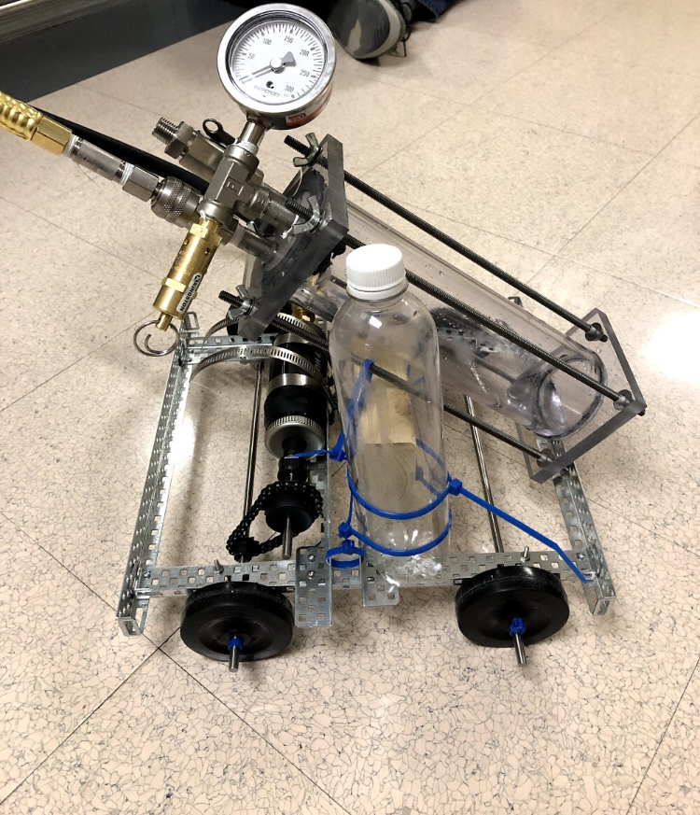

ChemE Car
Mission: Design a small chemically powered and stopped car. The closest to the stopping line wins.
~30 members
Goal: Compete in the Spring 2020 regional competition
Three teams: Battery, Pressure, Stopping

Slide 8
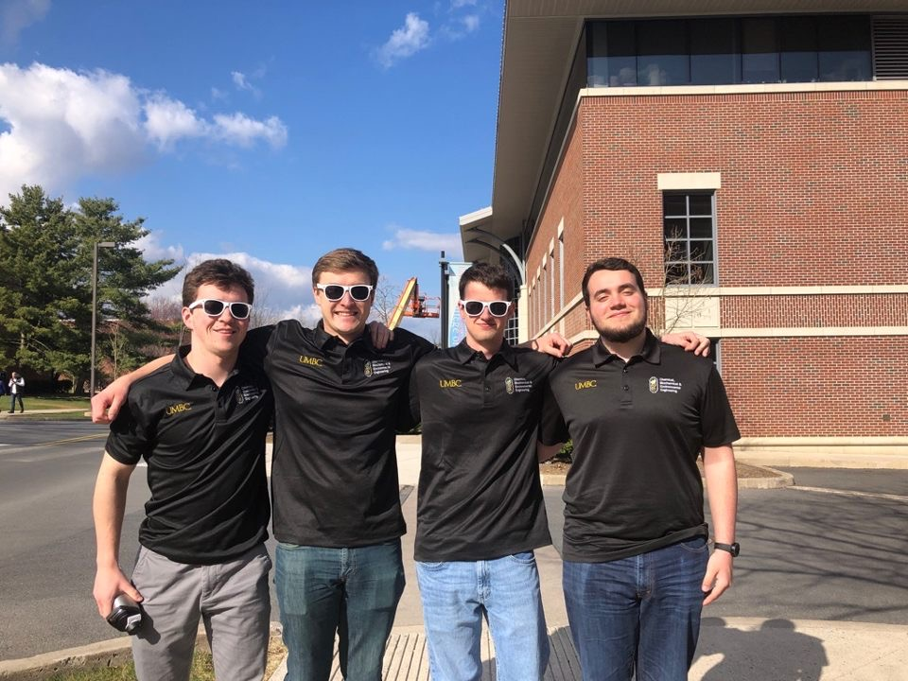

ChemE Jeopardy
Competition at Regional and National AIChE conference
5 ChemE categories, 1 random
Choose team through series of games
Top 4 join come to AIChE regional competition to compete

Slide 9

First Year Representative
Name, Intended Track
Why do you think you are right for the position?
What do you want to do after you graduate?
FunFact: Who is your favorite Scientist and why?
Email slide to aiche@umbc.edu

Slide 10
Course Questions?
ENES 101
ENCH 225 Fall
ENCH 300
ENCH 215
ENCH 425 Frey
ENCH 444
ENCH 445 (Good Luck)

Slide 11
BATTLE OF THE CLASSES!
Follow us on:
MY.UMBC.EDU
FB: @umbc_AIChE
Twitter: @umbc_AIChE
Instagram:umbc_cheme_car

