Slide 1
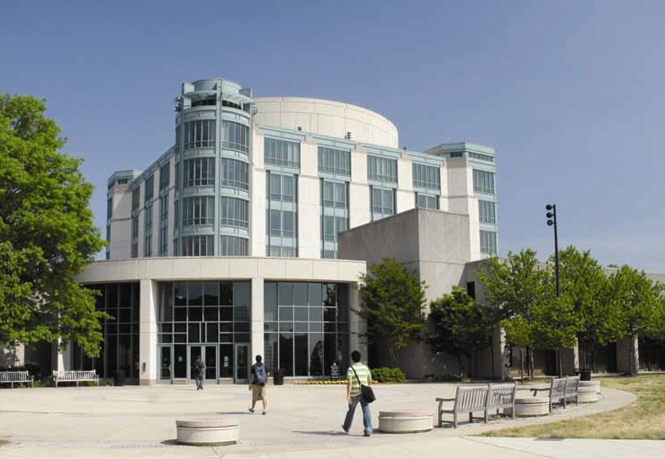

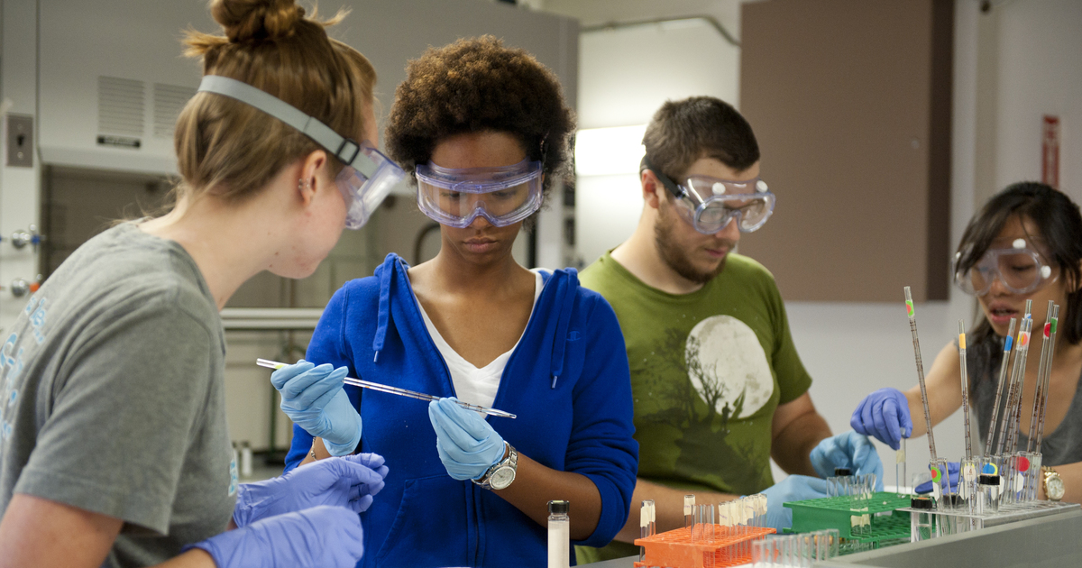
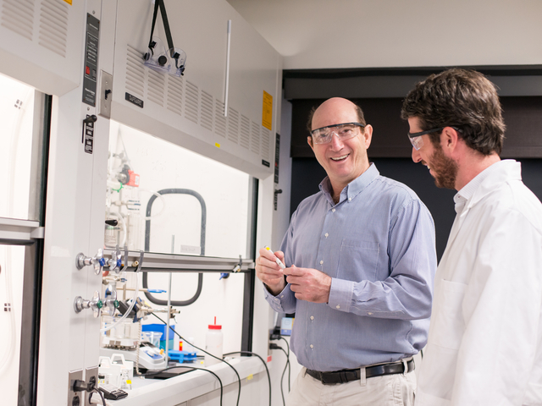


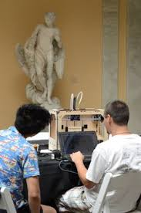

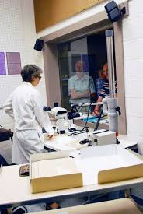
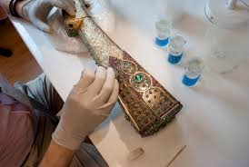
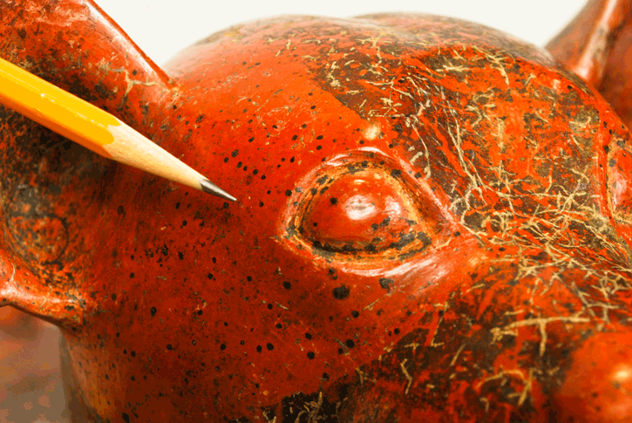
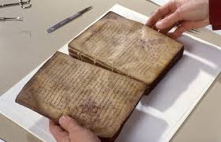

An Andrew W. Mellon Foundation Supported Summer Research Program for Baltimore Area Undergraduate Students in Chemistry, Materials Science, and Engineering Aspects of Art Conservation
Applicants for this 10-week research experience for undergraduate students in Baltimore area academic institutions should be U.S. citizens or permanent residents, pursuing science and engineering majors or arts majors with science or engineering minors, maintaining a GPA of 3.0 or greater, and interested in chemistry, materials science and engineering aspects of art conservation.
Application Deadline – February 19, 2016
To learn more and to apply visit
http://chemistry.umbc.edu/sciart/
Program benefits include:
Collaborative research experience mentored by UMBC and Johns Hopkins University Research Faculty, and Walters Art Museum Scientists and Conservators.
A $5,000 stipend, on-campus housing, field trips to area museum laboratories, and social activities
Professional training workshops
Outreach activities in Baltimore City
Contact Information
Program Site Manager
Justine M. Johnson
j.johnson@umbc.edu
(410)455-3124
Director
Dr. Zeev Rosenzweig
Professor and Chair
Department of Chemistry and Biochemistry
zrosenzw@umbc.edu

