Slide 1
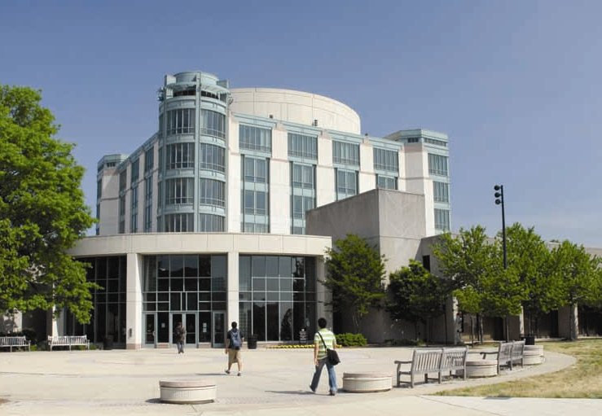
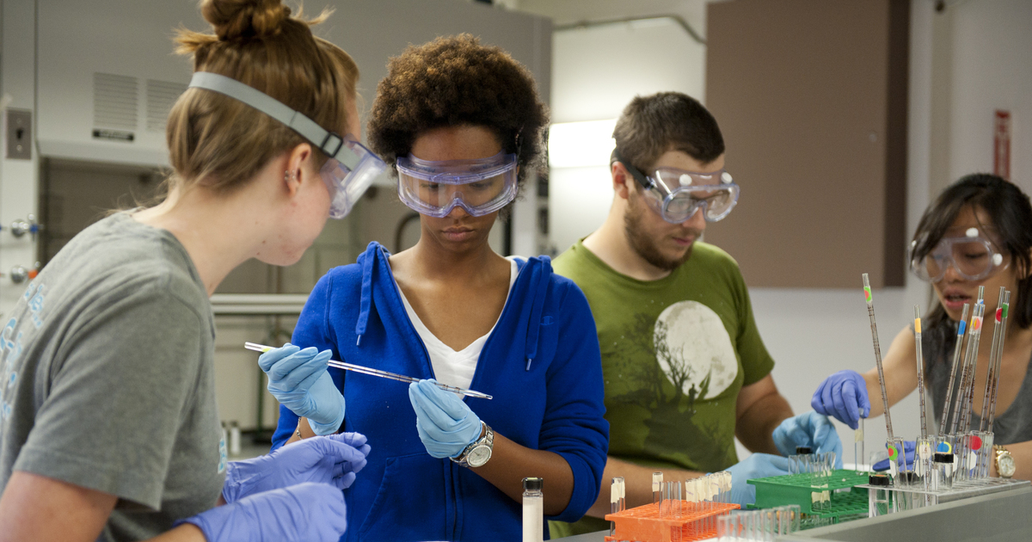
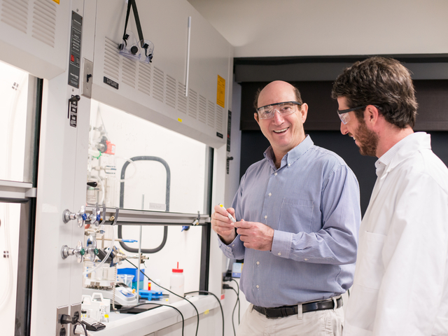
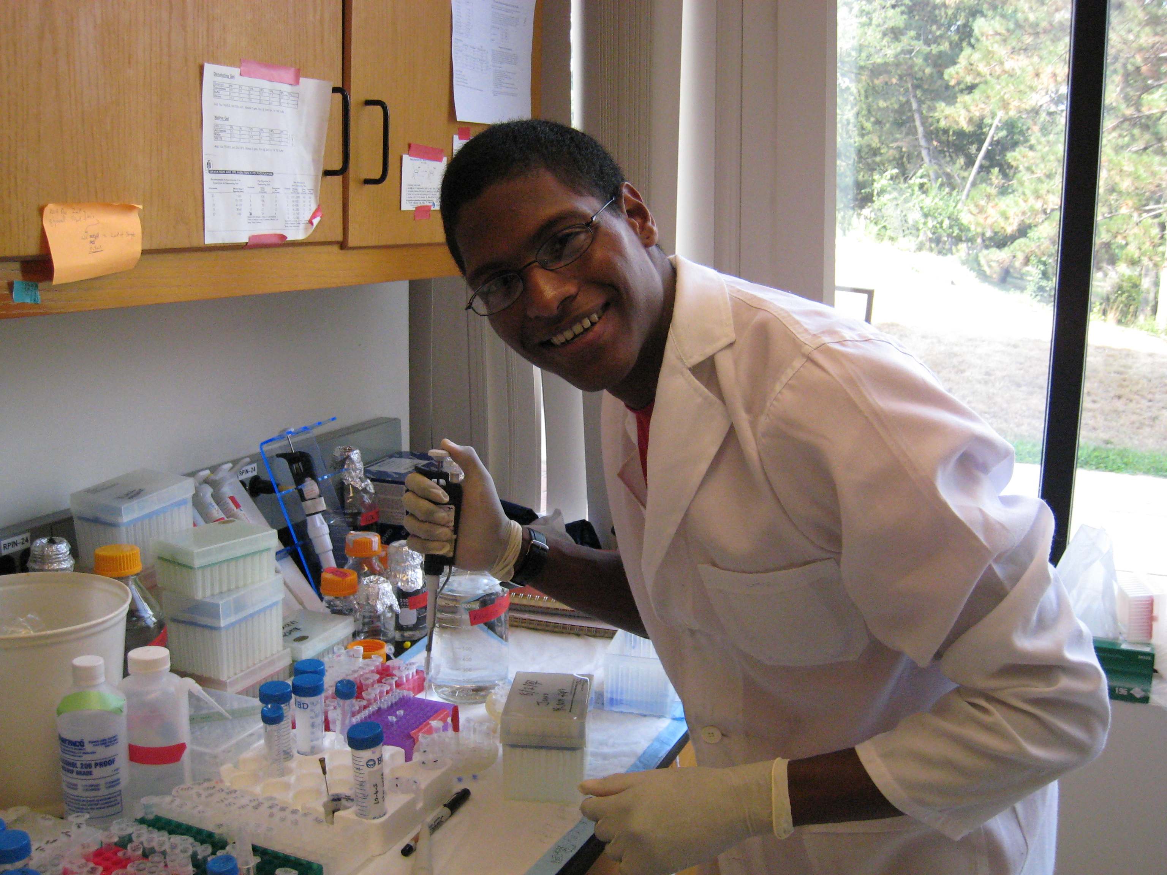
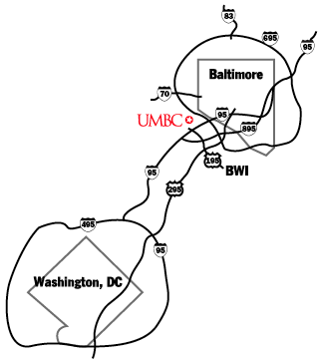
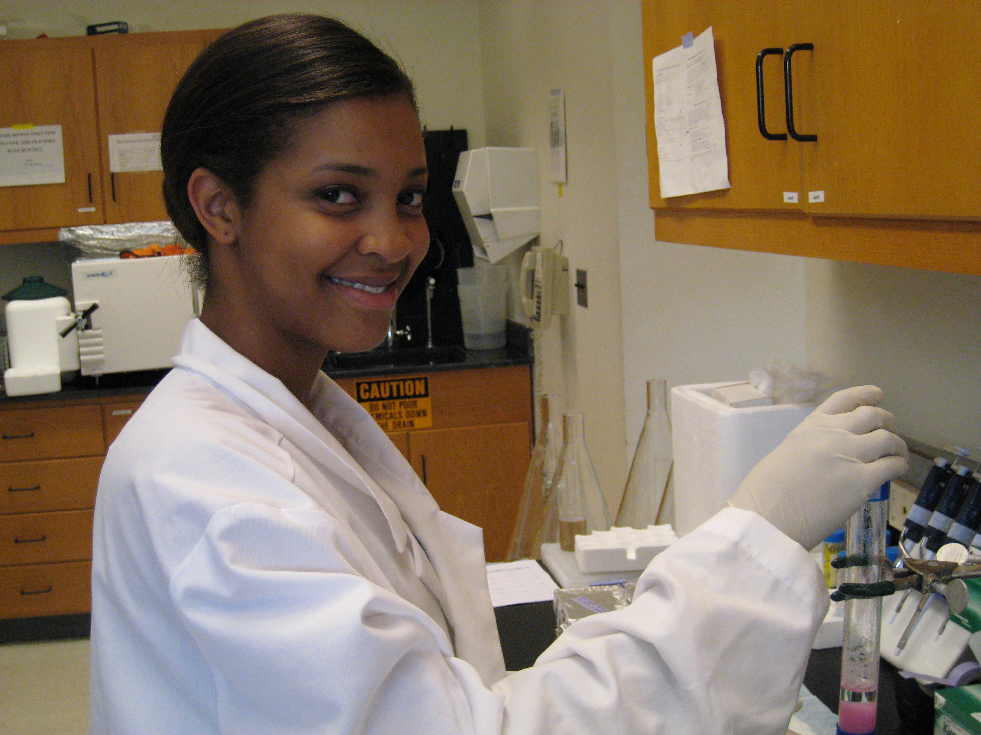
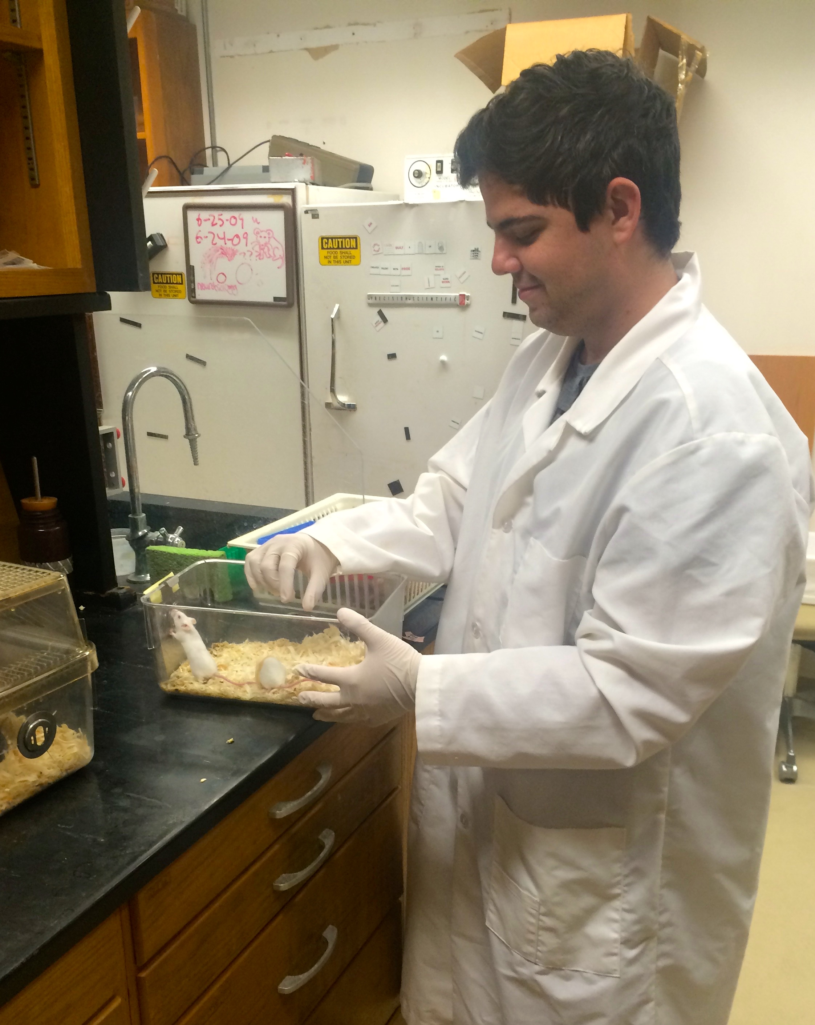
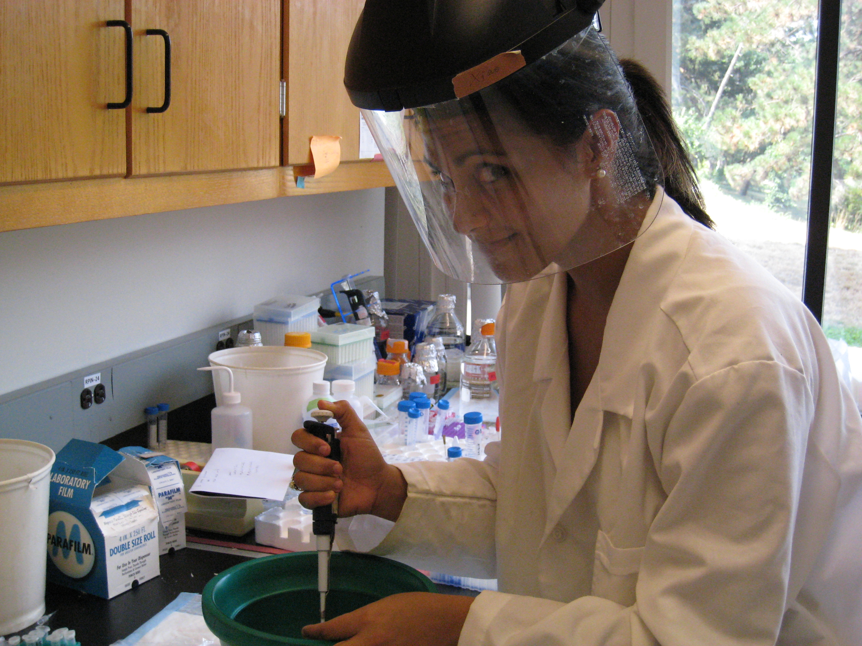
Department of Chemistry and Biochemistry
An NSF Research Experience for Undergraduates (REU) Program in Chemical Sensing and Imaging at UMBC
For more information
over the internet, visit
http://chemistry.umbc.edu/research-experience-for-undergrads-program/
Applicants for this 10-week research experience for undergraduate students in U.S. academic institutions who are U.S. citizens or permanent residents, pursuing B.Sc. degrees in chemistry and biochemistry or related fields, maintaining a GPA of 3.0 or greater, and are considering applying to graduate school in the chemistry and biochemistry or related fields upon completion of their undergraduate degree.
Application Deadline – February 19, 2016
To learn more and to apply visit
http://chemistry.umbc.edu/research-experience-for-undergrads-program/
Program benefits include:
Research experience in leading UMBC laboratories in the area of chemical sensing and imaging.
A $5,000 stipend, on-campus housing, and social activities
Professional training workshops.
Contact Information
REU Site Manager
Justine M. Johnson j.johnson@umbc.edu
(410)455-3124
Associate Director
Dr. Steve Mang
Department of Chemistry and Biochemistry smang@umbc.edu
Director
Dr. Zeev Rosenzweig Professor and Chair
Department of Chemistry and Biochemistry zrosenzw@umbc.edu
UMBC takes advantage of its prime location
on the Baltimore-Washington corridor to forge
links with government, business, and industry.
High-tech corporations and laboratories are
key partners with the UMBC community

